Slide 1
Decentralized Fund Management
07/09/2021

Slide 2
Introduction - DFM
FM is the process of overseeing assets and managing its cash flow to generate a return on investments.
DFM is conducted without an investment manager
Instead, algorithms help you conduct trades automatically
To understand how fund management can work in the decentralized ledger, we will explore Token Sets

Slide 3

TokenSets
TokenSets is a platform that allows crypto users to buy Strategy Enabled Tokens (SET)
These tokens have automated asset management strategies
That will enable you to easily manage your cryptocurrency portfolio without executing the trading strategy manually
With an automated trading strategy, you will not need to monitor the market 24/7 manually
Really helpful to reducing missed opportunities and risks from emotional trading

Slide 4
TokenSets
Each Set is an ERC20 token consisting of a basket of cryptocurrencies
It will automatically rebalances its holdings based on the strategy you choose
SET essentially implements cryptocurrency trading strategies in the form of tokens

Slide 5
What kind of
There are now two kinds of Sets
Index Sets
allow users to have exposure to more assets
reduce gas fees by purchasing a single token instead of buying multiple assets individually
The most popular Index Set is the DeFiPulse Index (DPI)
an index that tracks DeFi tokens’ performance based on a market capitalization-weighted index

Slide 6
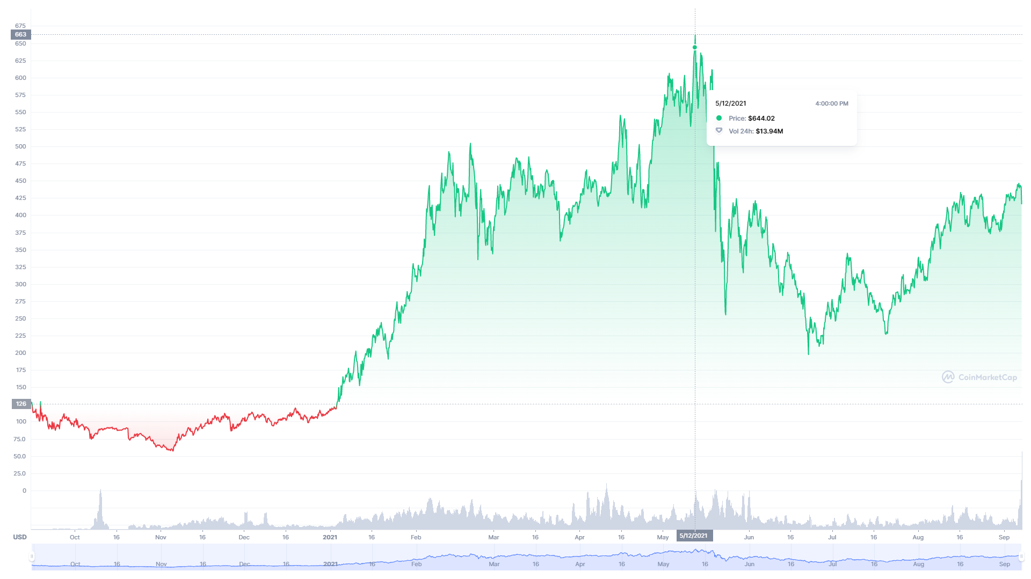
DeFi Pulse Index
https://coinmarketcap.com/currencies/defi-pulse-index/
Notes:
https://coinmarketcap.com/currencies/defi-pulse-index/

Slide 7
DeFi Pulse Index (DPI)
As of April 2021, there are 14 DeFi assets under DPI:
Uniswap (UNI), Aave (AAVE), Synthetix Network Token (SNX), Sushiswap (SUSHI), Maker (MKR), Compound (COMP), Yearn.Finance (YFI), REN (REN), Loopring (LRC), Balancer (BAL), Kyber Network (KNC), Harvest Finance (FARM), Cream Finance (CREAM) and Meta (MTA)
To monitor individual token:
https://www.dextools.io/app/ether/pair-explorer/0x9f178e86e42ddf2379cb3d2acf9ed67a1ed2550a (UNI)
https://www.dextools.io/app/ether/pair-explorer/0xd75ea151a61d06868e31f8988d28dfe5e9df57b4 (AAVE)
https://www.dextools.io/app/ether/pair-explorer/0x43ae24960e5534731fc831386c07755a2dc33d47 (SNX)
https://www.dextools.io/app/ether/pair-explorer/0x73a6a761fe483ba19debb8f56ac5bbf14c0cdad1 (SUSHI)
Notes:
https://coinmarketcap.com/currencies/defi-pulse-index/

Slide 8
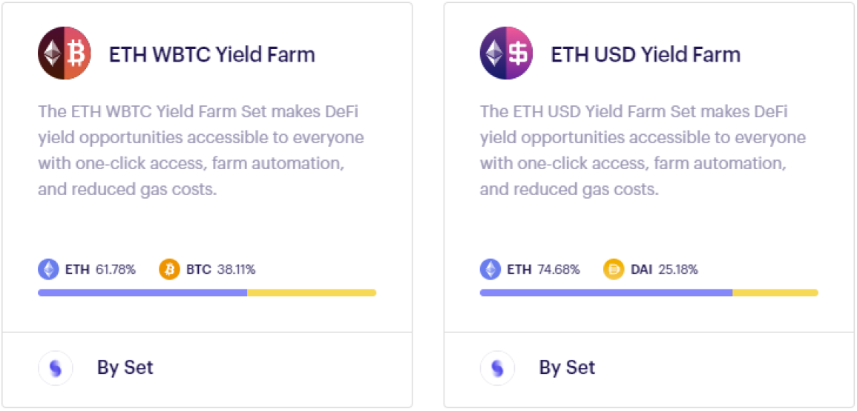
What kind of
Yield Farming Sets
Yield farming is the practice of staking or lending crypto assets in order to generate high returns or rewards in the form of additional cryptocurrency
Yield farming is a process that allows cryptocurrency holders to earn rewards on their holdings. With yield farming

Slide 9
How Sets are helpful
Sets essentially tokenize trading strategies
Suppose you are keen to try out selected trading strategies, such as purchasing a diversified basket of assets
In that case, Set is likely the easiest way to go about doing so
Always do your due diligence
historically been performing well does not mean that it will continue to do so
The cryptocurrency market is highly volatile
“past performance is not an indicator of future results”
Instead, research and compare the available strategies to see which one makes the most sense to you,

Slide 10
TokenSets: Step by Step
Step 1
Go to https://www.tokensets.com/
Click “Sign In” on the top right corner
Choose sign in with Metamask or any wallet of your choice
Step 2
It will redirect you to a new interface
A popup will ask for your email address. You can choose to ignore it as it is optional.
Step 3
Eventually you will arrive at the Explore page
You can see a list of Sets that are available.
Index Sets typically has the word “Index” and Farm Index has the word “Farm”
For example: “DeFi Pulse Index” and “ETH-USD Yield Farm”

Slide 11
TokenSets: Step by Step
Step 4
Let’s take a look at how to buy one of the Sets. We chose the DeFi Pulse Index as an example.
Click on DeFi Pulse from Explorer
Then, click “Buy”
A pop-up window will show
You can choose to buy it with one of the four supported currencies
We chose to buy 80 USDC ($80) worth of DPI
Click “Submit”
Step 5
You will need to approve for TokenSets to spend your USDC
Click “confirm” on your Metamask

Slide 12
TokenSets: Step by Step
Step 6
Once approval confirmed, you can now submit your buy
Another transaction approval is required
Click “confirm” on your Metamask
You are done!

Slide 13
Thank You

